Slide 1
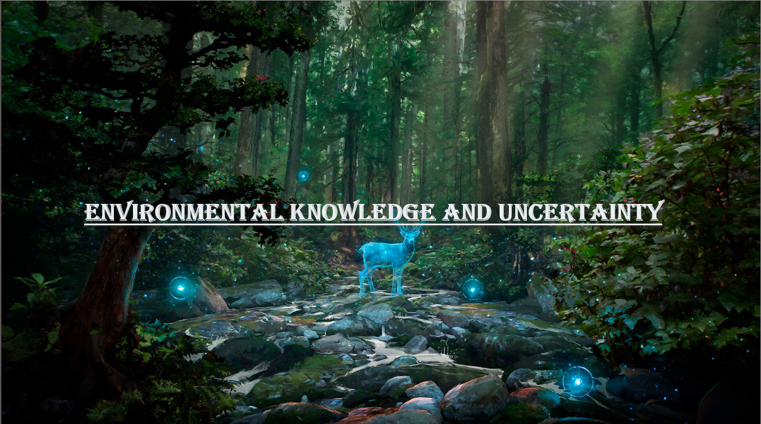

Slide 2
ENVIRONMENTAL KNOWLEDGE AND UNCERTAINTY
BY
MAYUKH PAUL AND ROHIT ROY
1ST YEAR BSC ECONOMICS
ENVIRONMENTAL ECONOMICS
SISTER NIVEDITA UNIVERSITY (SNU)
SLIDE 1
SLIDE 1

Slide 3
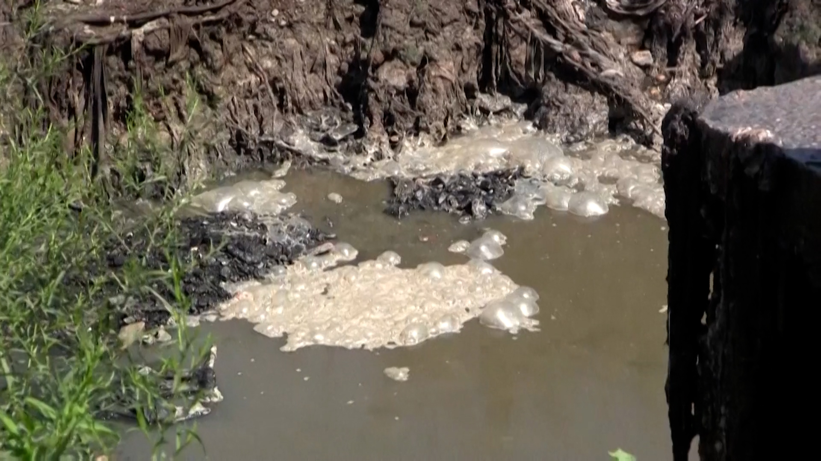

2.1 ECOSYSTEM AND DYNAMIC INTEGRITY
SLIDE 2
Ecosystem does not exist in steady state, but exhibit continuous change in production and species composition
Experiment in laboratory and field studies.
Page - 1

Slide 4
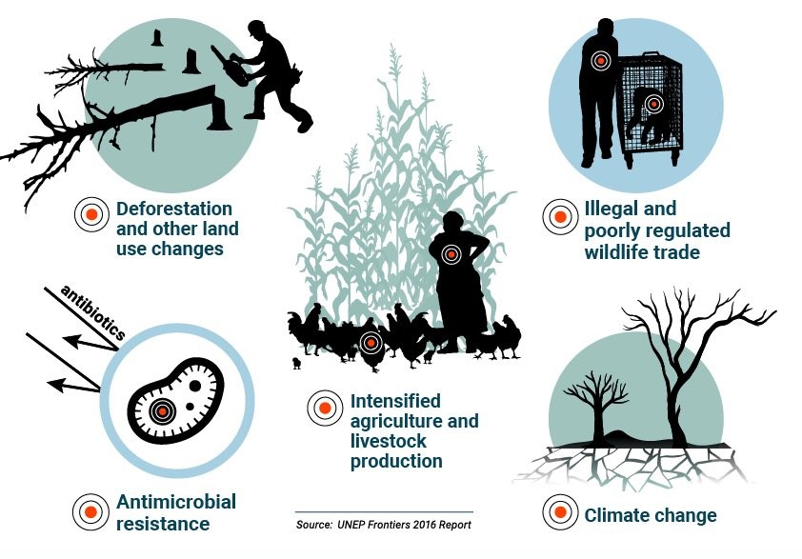
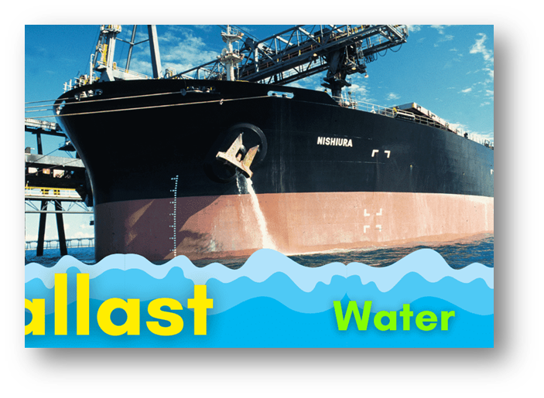
2.2 ecosystem productivity and environmental health
SLIDE 3
Slide 3
Human activities on system productivity and conservation
Transfer of Ballast Water being the major problem
Birth of non-indigenous organism
Page - 2

Slide 5

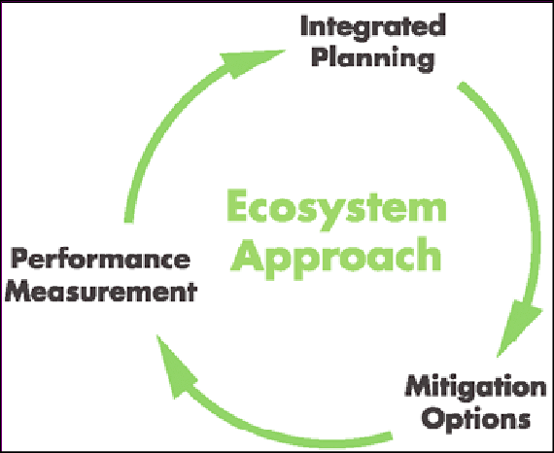
2.3 ecosystem-based management
SLIDE 4
To ensure the intergenerational sustainability of ecosystem goods
Ecosystem-based approach
Page - 3

Slide 6

2.4 understanding the sources of uncertainty
Uncertainty cannot be removed it
has to be clarify.
Some of the environmental issues which got harmed due to Uncertainty are–
1. Climate Change
2. Change in freshwater flow
3. Mixing and sediment exchanges
and fluxes

Slide 7
1. Major difficulties of environmental Risks
Highly interdisciplinary
Social dimension
Different theoretical experiments
Fields – varying states maturity

Slide 8
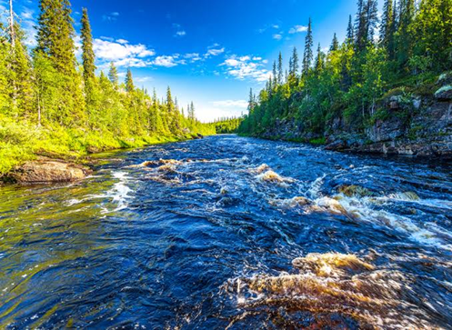
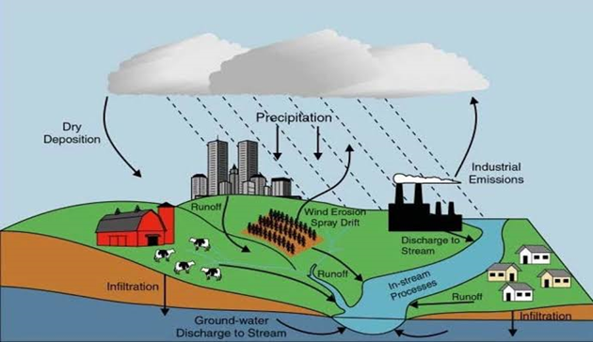
2. Problem of policy of Environmental Risks
Social dimension
Sensitive area : return of foreign aids
Oil Spills
Environmental pollution
Dumping waste

Slide 9

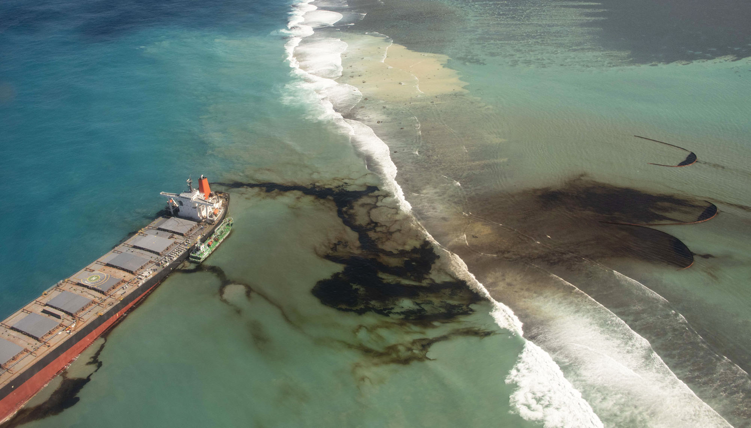
2.5 Communicating and understanding of Environment risks
Issues included –
Chemical pollution
Air pollution
Poor water quality
Poor Infrastructure
Climate changes
Disease-causing microbes

Slide 10

1. Major difficulties of Environmental Risks
Highly interdisciplinary
Social dimension
Different theoretical experiments
Fields – varying states maturity

Slide 11


2. Problem of policy of Environmental Risks
Social Dimension
Sensitive area : return of foreign aids
Oil spills
Environment pollution
Dumping waste

Slide 12


3. High probability problems of Environmental Risks
Failure of Investment
Long term usage : Chemical global warming

Slide 13

Slide 9
conclusion
From the above topic we conclude that Environmental Knowledge is a dynamic process. The priority of such knowledge is to develop cautious mind of people about their total surrounding.
Without proper information uncertainty cannot be removed it has to clarify. Different steps can be taken to reduce the impact of Environmental Risks such as understanding the importance and value of natural resources , etc…
BBA UEM
Page - 8

Slide 14

Slide 11

